Slide 1
MINES-VIS
Week 3

Slide 2
TOPICS in brief week 3
Topics Image Processing:
Edge detection
The Canny Edge detector the Algorithm
Edge detector in steps
Code Examples C++ OpenCV published on SharePoint.

Slide 3
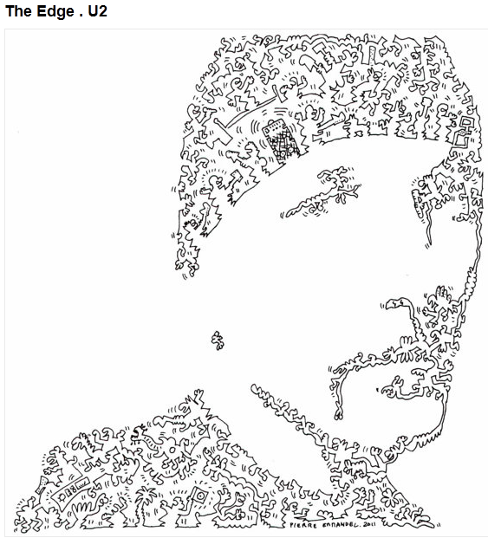
What Are Edges?
Simple answer: discontinuities in intensity

Slide 4
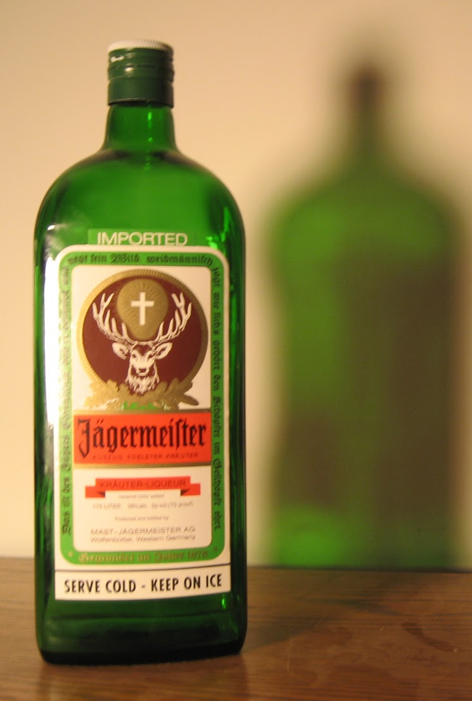
Edge Detection
What causes edges?
Boundaries of objects
Boundaries of lighting (shadows)
Material color
Material differences

Slide 5
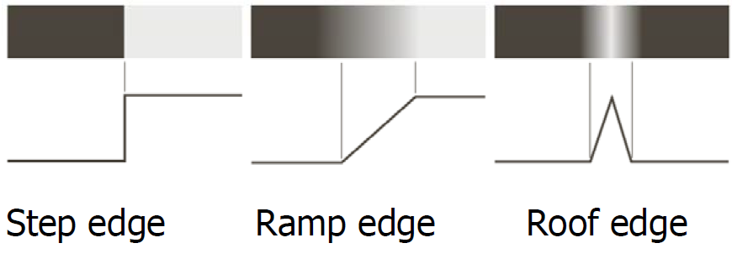
Edge Detection
Edges and their corresponding intensity profiles.

Slide 6
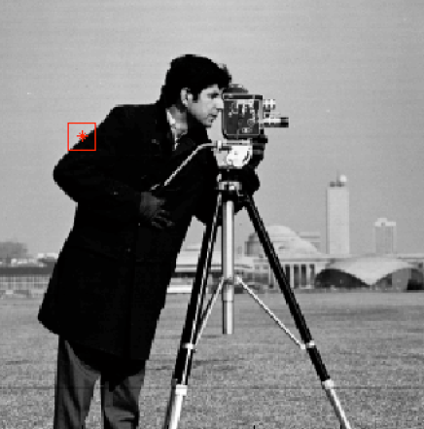
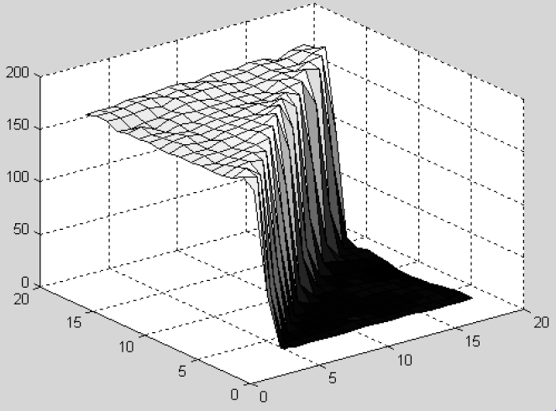
Step Edges.

Slide 7
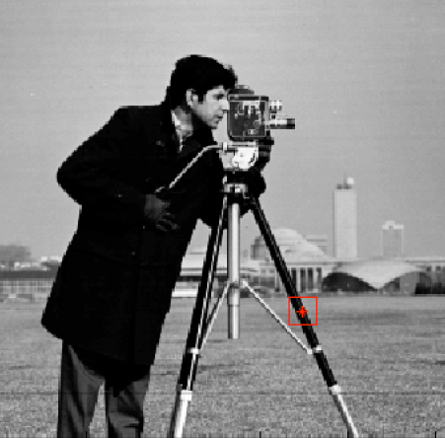
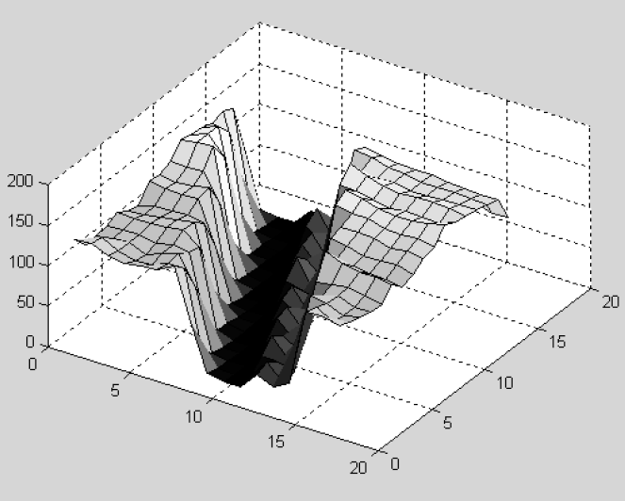
Ramp Edges.

Slide 8
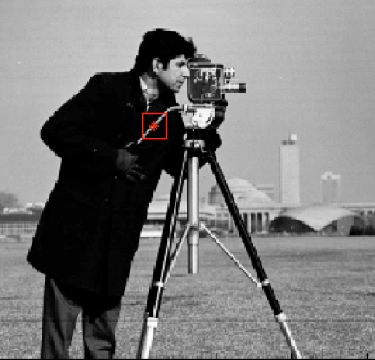
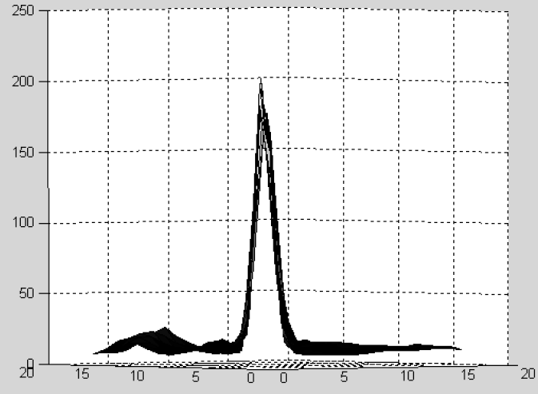
Roof Edges.

Slide 9
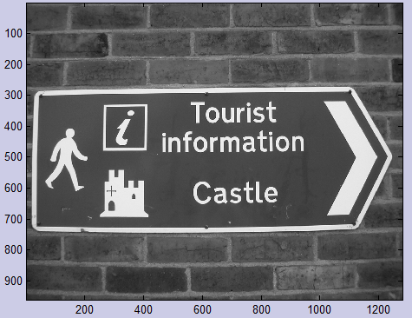
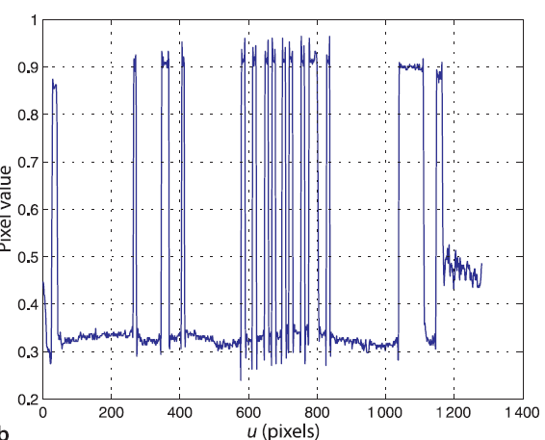
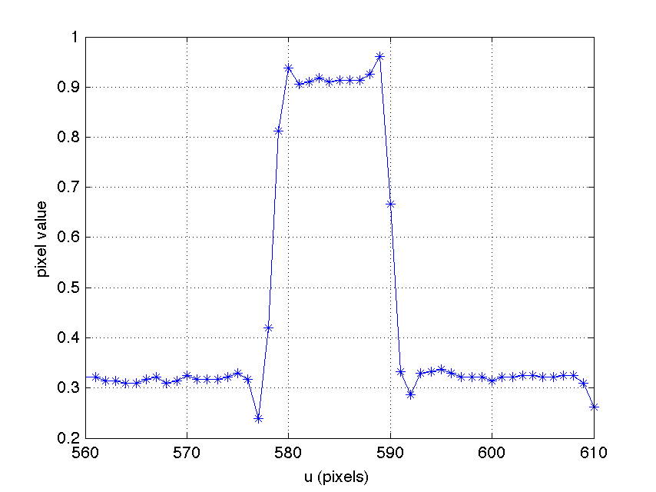
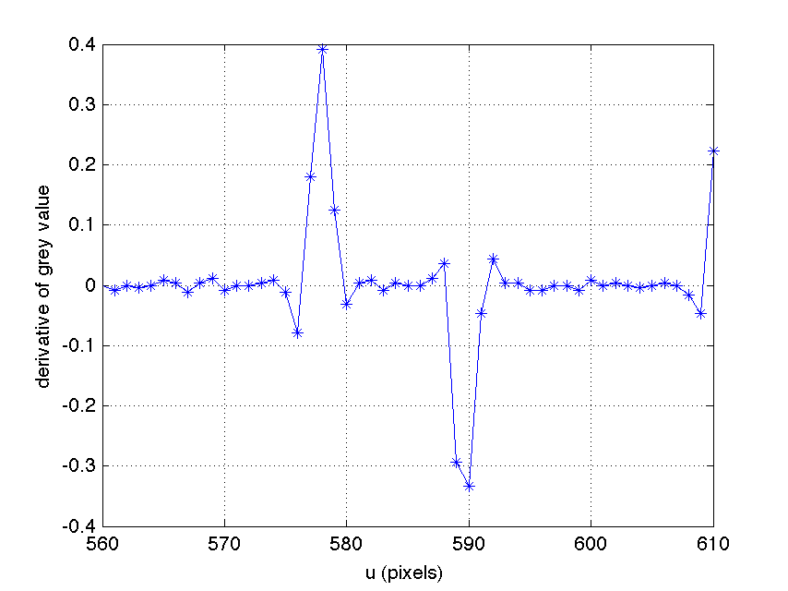
Edge detection
See also this link: Sobel Derivatives

Slide 10
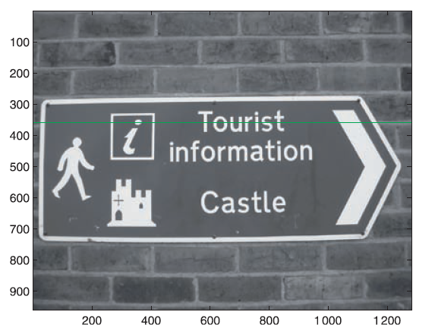
The derivative at point v can also be written as a symmetrical first-order difference

Slide 11
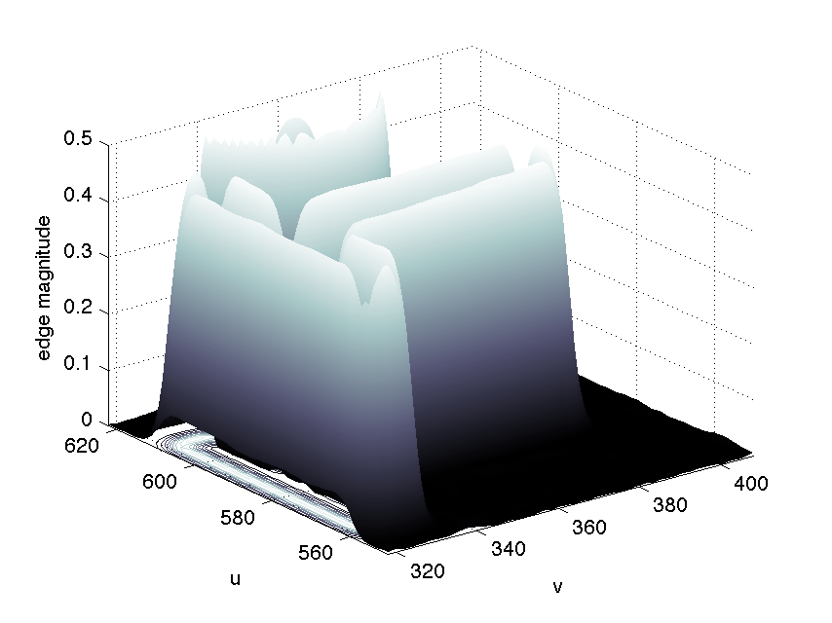
Edge detection
The Sobel Operator is a discrete differentiation operator.
The Sobel Operator combines Gaussian smoothing and differentiation.

Slide 12
Canny Edge Detector
Is a multistage edge detection algorithm.
Preprocessing
Filter out any noise. The Gaussian filter is used for this purpose.
Calculating gradients
Apply Sobel operation convolution mask in X and Y direction, find the gradient strength and direction.
Nonmaximum suppression
This removes pixels that are not considered to be part of an edge. Hence, only thin lines (candidate edges) will remain.
Thresholding with hysteresis
Two thresholds are using, (upper and lower)
if a pixel gradient is higher than the upper threshold, the pixel is accepted as an edge.
If a pixel gradient is below the lower threshold, then it is rejected
If the pixel gradient is between the two thresholds, then it will be accepted only if it is connected to a pixel that is above the upper threshold.
Notes:
Filter out any noise. The Gaussian filter is used for this purpose.
Apply Sobel operation convolution mask in X and Y direction, find the gradient strength and direction. ( rounded in of four possible angles 0, 45, 90 or 135 degrees.
This removes pixels that are not considered to be part of an edge. Hence, only thin lines (candidate edges) will remain
Two thresholds are using, (upper and lower)
if a pixel gradient is higher than the upper threshold, the pixel is accepted as an edge.
If a pixel gradient is below the lower threshold, then it is rejected
If the pixel gradient is between the two thresholds, then it will be accepted only if it is connected to a pixel that is above the upper threshold.

Slide 13
Canny Algorithm in OpenCV
C++: void Canny(InputArray image, OutputArray edges, double threshold1, double threshold2,
int apertureSize=3, bool L2gradient=false )
image - single-channel 8-bit input image. CV_8UC1 format (each pixel is a single byte).
edges – output image; same size and type as image
threshold1 – first threshold for the hysteresis procedure
threshold2 – second threshold for the hysteresis procedure
apertureSize – aperture size for the sobel() operator
L2gradient – a flag, indicating whether a more accurate magnitude gradient
See also following link for a: Code Example of a Canny Edge detector.

Slide 14
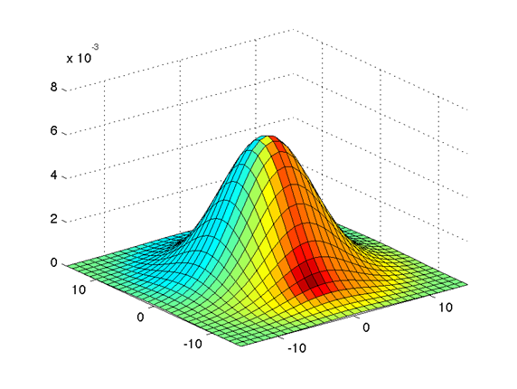
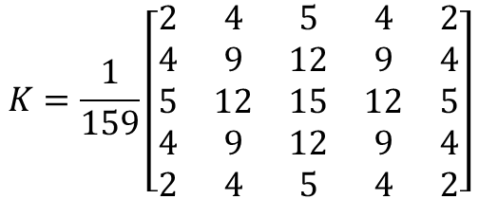
Steps performed by the Canny Edge Detector
Preprocessing
1.Filter out any noise. The Gaussian filter is used for this purpose. An example of a Gaussian kernel of size = 5 that might be used is shown below:
$$K=\frac{1}{159}\left[\begin{matrix}2 & 4 & 5 & 4 & 2 \\ 4 & 9 & 12 & 9 & 4 \\ 5 & 12 & 15 & 12 & 5 \\ 4 & 9 & 12 & 9 & 4 \\ 2 & 4 & 5 & 4 & 2\end{matrix}\right]$$
Gaussian filter
Another example: cv::GaussianBlur(src, workImg, cv::Size(5, 5), 1.4);

Slide 15
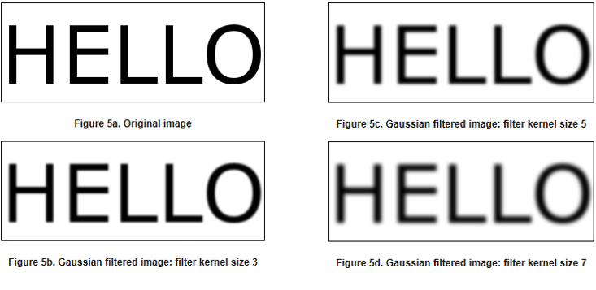
Steps performed by the Canny Edge Detector
Preprocessing
Examples

Slide 16

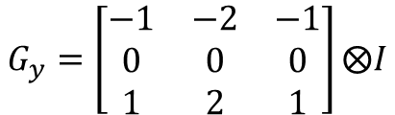
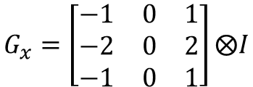
Steps performed by the Canny Edge Detector
Calculating Gradients
The Sobel operator is used for this purpose.
Assuming that the image to be operated is $Ι$
Horizonal Changes $G_{x}$ : Convolving $Ι$ with a kernel with odd size, example a 3x3 kernel.
$$G_{x}=\left[\begin{matrix}−1 & 0 & 1 \\ −2 & 0 & 2 \\ −1 & 0 & 1\end{matrix}\right]⨂Ι$$
Vertical Changes $G_{y}$ : Convolving $Ι$ with a kernel with odd size, example a 3x3 kernel.
$$G_{y}=\left[\begin{matrix}−1 & −2 & −1 \\ 0 & 0 & 0 \\ 1 & 2 & 1\end{matrix}\right]⨂Ι$$
At each point of the image we calculate an approximation of the gradient in that point by combining both results above.
Notes:
Calculating 2 derivatives…. In X and Y direction

Slide 17
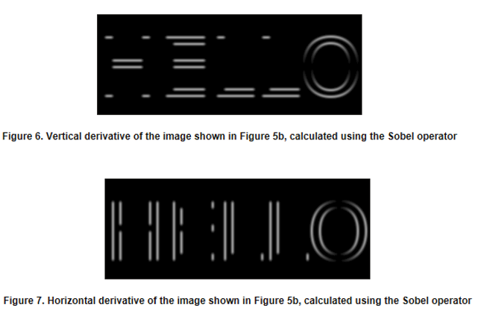
Steps performed by the Canny Edge Detector
Calculating Gradients

Slide 18


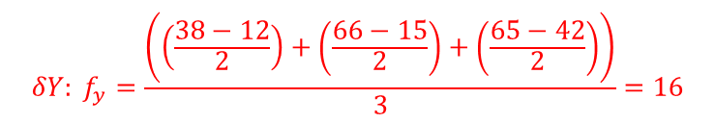


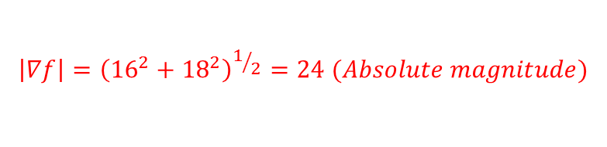
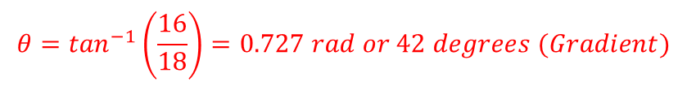



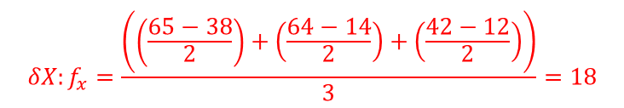


Steps performed by the Canny Edge Detector
Calculating Gradients
-1
0
1
1
2
1
$$s_{x}=$$
-2
0
2
$$⊗Image$$
$$s_{y}=$$
0
0
0
$$⊗Image$$
-1
0
1
-1
-2
-1
$⊗$ = convolution
Horizontal changes
Vertical changes
$$f_{y}$$
$$∇f$$
$${δY: f}_{y}=\frac{\left(\left(\frac{38−12}{2}\right)+\left(\frac{66−15}{2}\right)+\left(\frac{65−42}{2}\right)\right)}{3}=16$$
38
66
65
$$θ$$
14
35
64
$$f_{x}$$
$${δX:f}_{x}=\frac{\left(\left(\frac{65−38}{2}\right)+\left(\frac{64−14}{2}\right)+\left(\frac{42−12}{2}\right)\right)}{3}=18$$
12
15
42
$$θ=\tan^{−1}\left(\frac{16}{18}\right)=0.727 rad or 42 degrees (Gradient)$$
L2gradient
$$\left|∇f\right|={\left({16}^{2}+{18}^{2}\right)}^{1/2}=24 (Absolute magnitude)$$

Slide 19
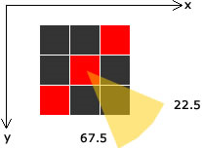
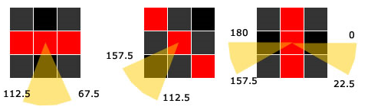

Steps performed by the Canny Edge Detector
Calculating Gradients

Slide 20

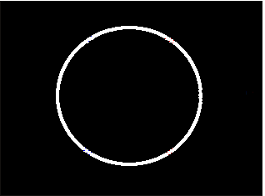
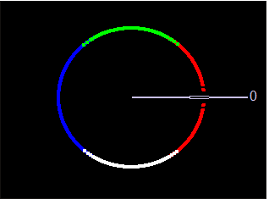
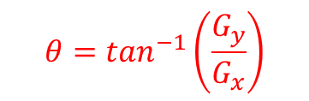
Steps performed by the Canny Edge Detector
Calculating Gradients
Image Gradient , result.
Example of visualizing the angle: Color-coded result of the angle equation using Gradient
$$θ=\tan^{−1}\left(\frac{G_{y}}{G_{x}}\right)$$
Notes:
GradientX: The result of the horizontal derivative (Sobel) of the image in the Gaussian Filter window.
GradientY: The result of the vertical derivative (Sobel) of the image in the Gaussian Filter window.
Magnitude: The result of combining the GradientX and GradientY images using the equation G = |Gx|+|Gy| $\left|∇f\right|={\left({16}^{2}+{18}^{2}\right)}^{1/2}$
Angle: using arctan(Gy/Gx).

Slide 21
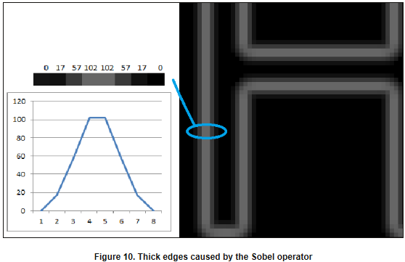
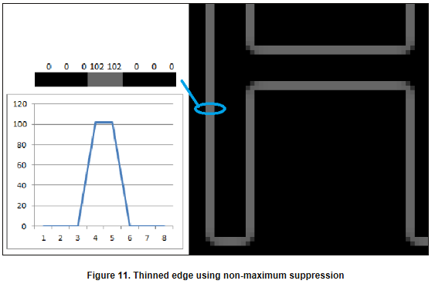
Steps performed by the Canny Edge Detector
Non-Maximum Suppression

Slide 22
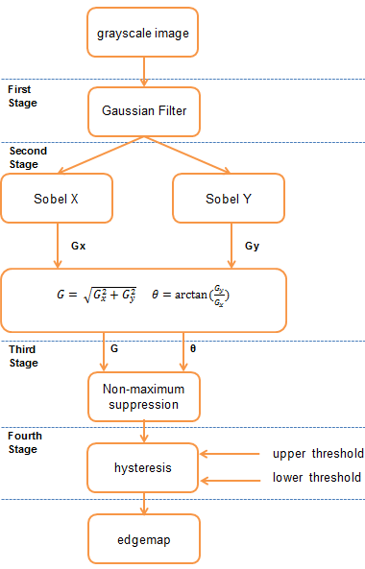
Steps performed by the Canny Edge Detector
Overview Algorithm

Slide 23
Questions ?
Thank you for listening

